Slide 1
UGBA 141 Production and Operations Management
Emerging II Operational Transparency
Professor Park Sinchaisri
Notes:
Agenda
Capability Analysis + Six Sigma
Ritz-Carlton Case
Service Excellence

Slide 2

Keeping Operations Out of Sight
Operations
Customers

Slide 3
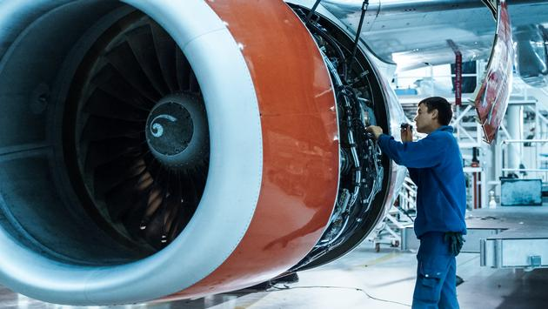
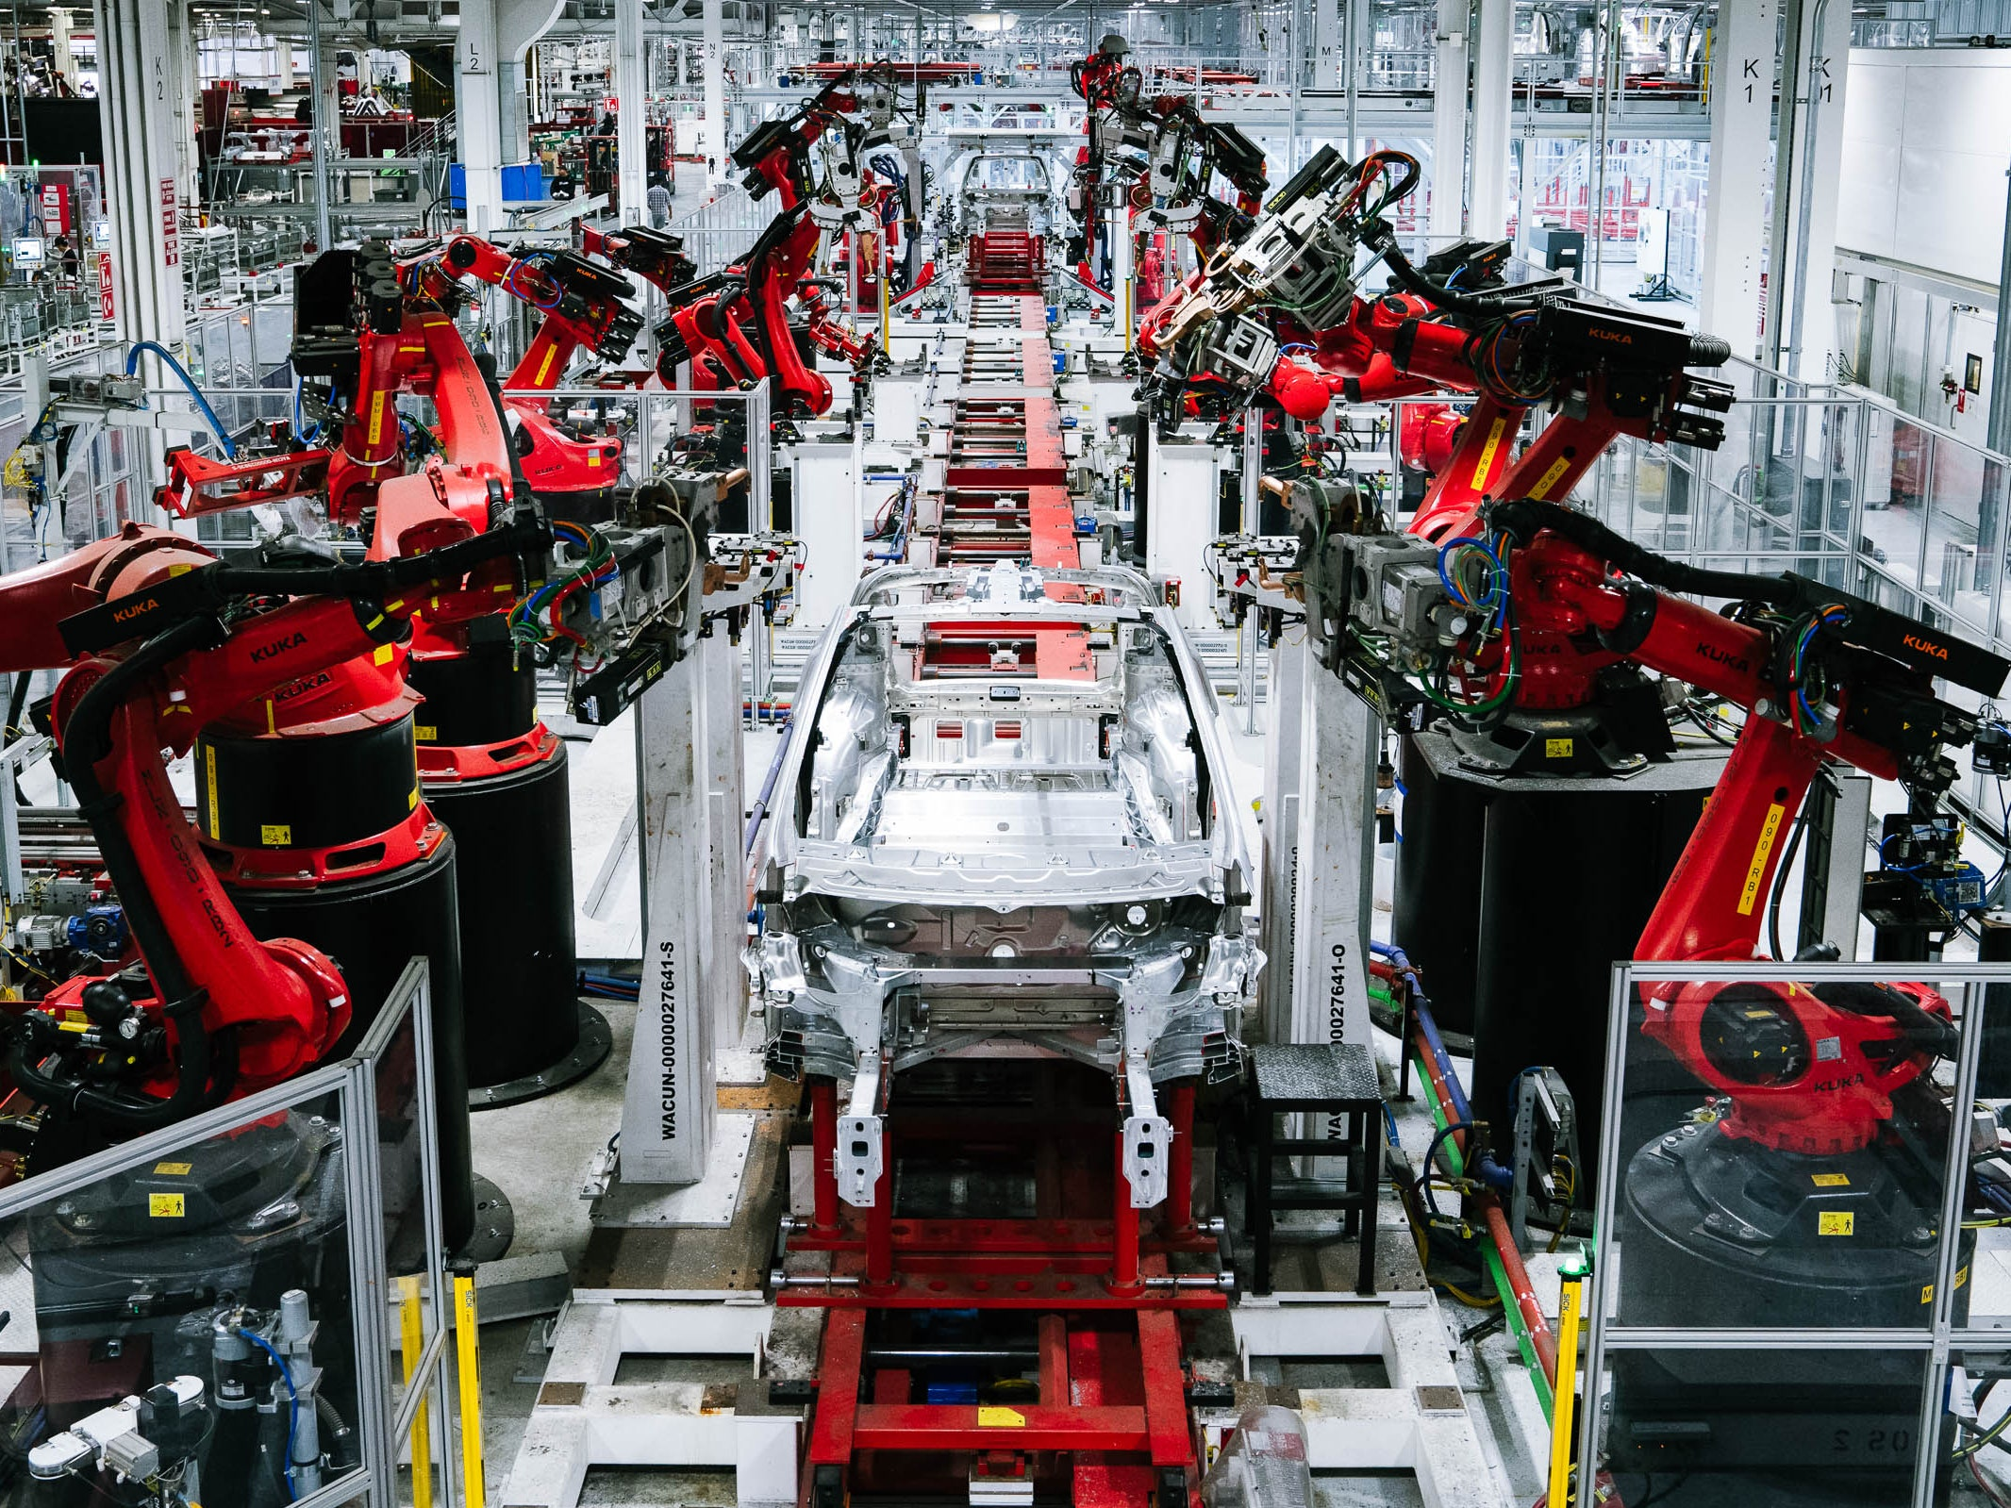
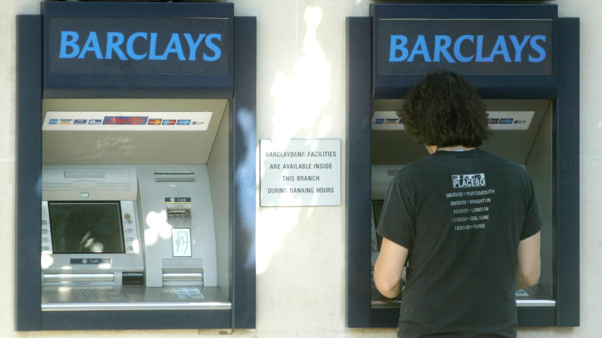
Out of Sight Advantages
Hide ”bad information”: scary, idle, variability, errors
Reduce variability
Improve efficiencies
Discourage complaints

Slide 4
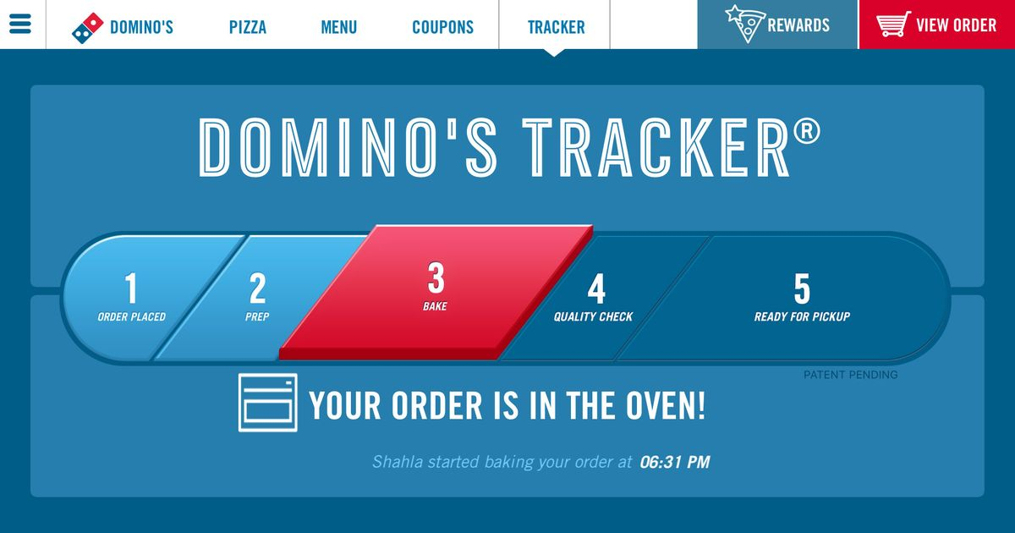

Operational Transparency
The deliberate design of windows into and out of the organization’s operations to help customers and employees alike understand and appreciate the value being created

Slide 5
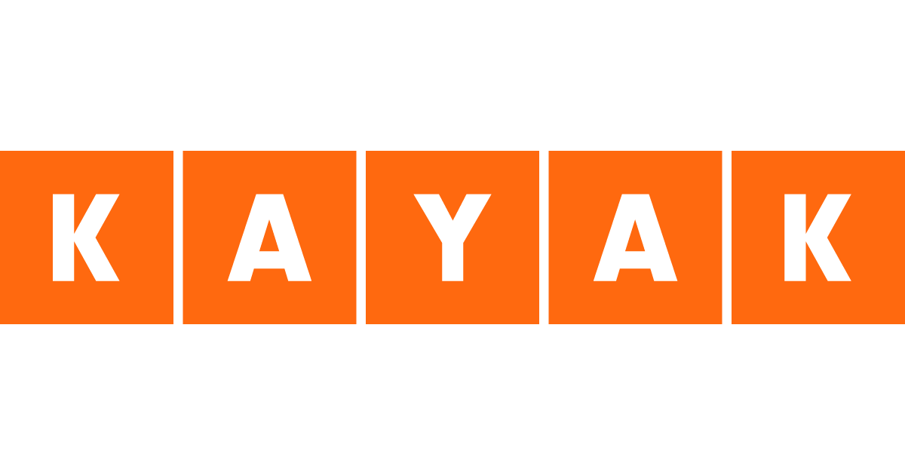
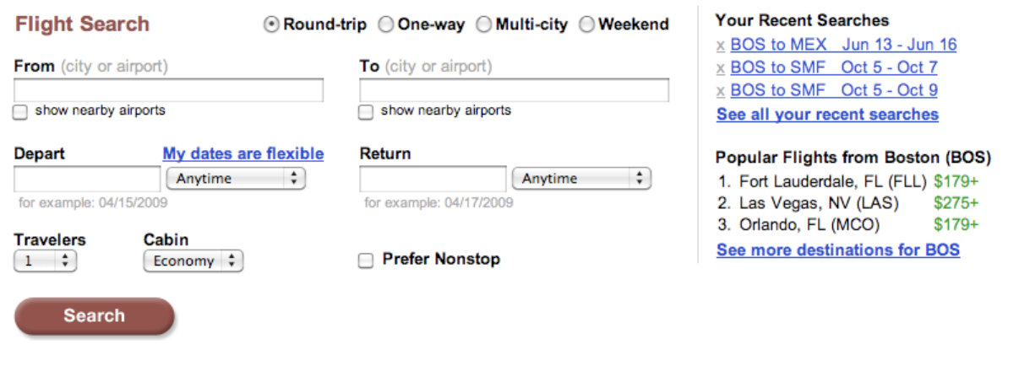
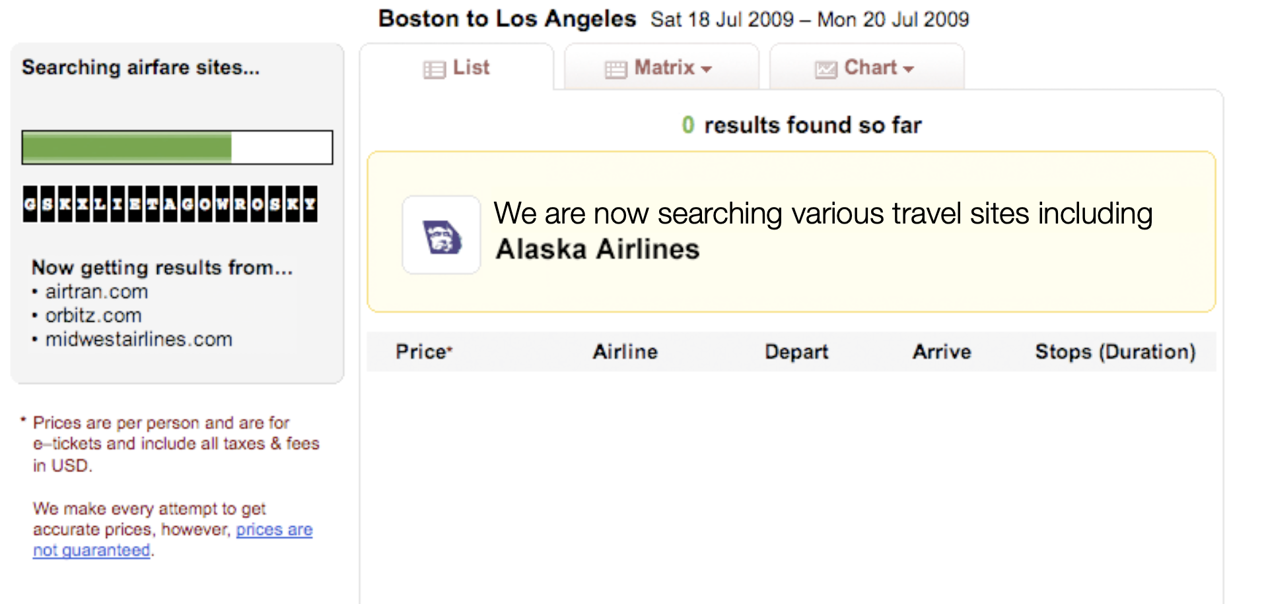
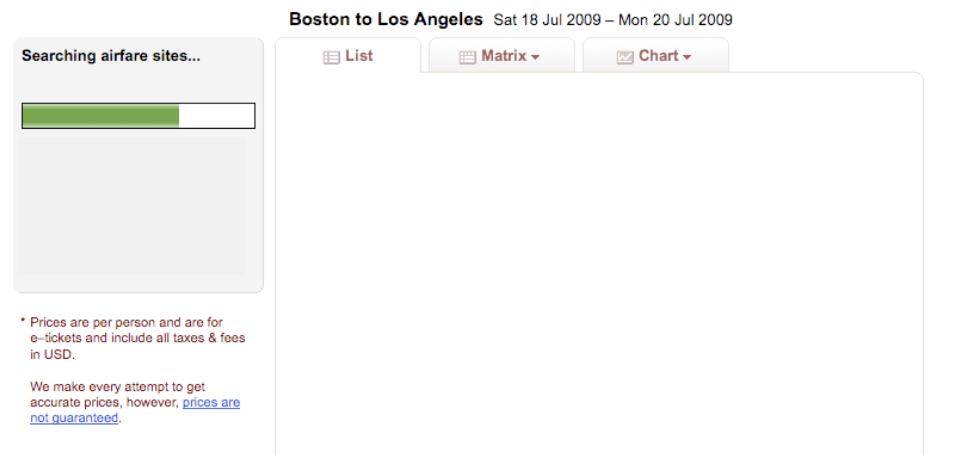

Slide 6
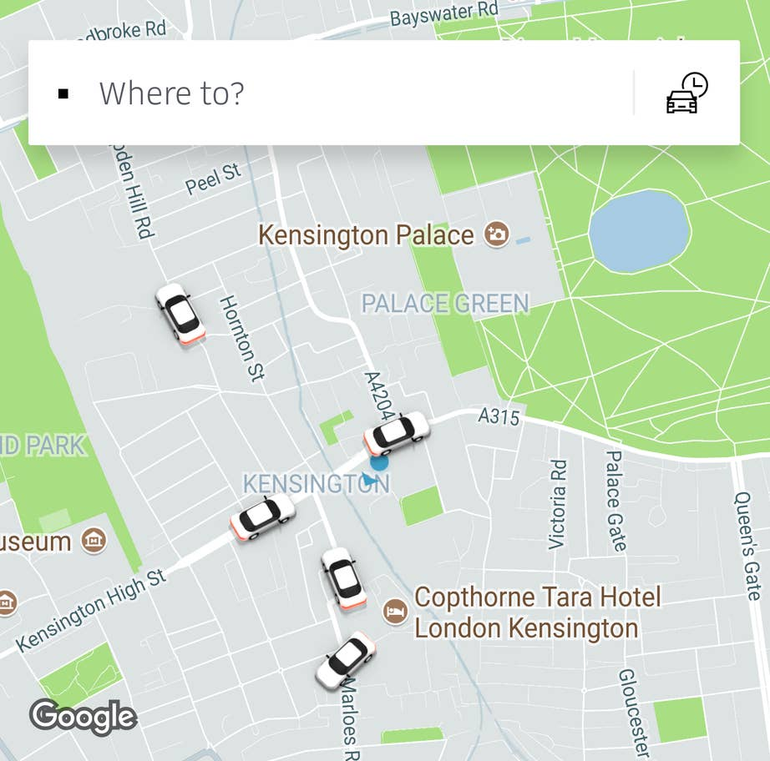
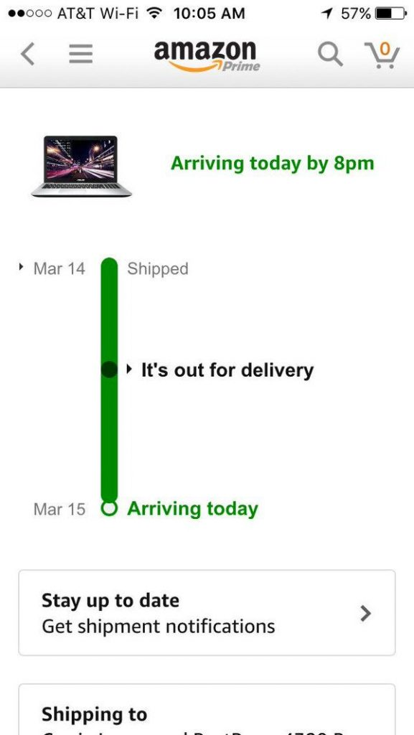

Slide 7
Transparency Advantages
For Customers
Build trust, confidence
Humanize the process, more appreciative of service
Less wait sensitive
For Employees
See customers benefitting from their efforts
Care more, exert greater effort
Greater monitoring

Slide 8
Transparency/Quality Ratings
Value perceived by customer (food satisfaction rating 1-7 points)
Operational transparency for employees improves food quality ratings

Slide 9
Transparency/Employees
Employees also work faster, and customers perceive service to be better...
Service Time
(seconds)
Value Perceived by Customer: Food Satisfaction Rating (1-7 point scale)
Blind
Reciprocal transparency
Blind
Reciprocal transparency

Slide 10
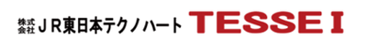
Case: Tessei

Slide 11
Tessei Cleaning the Shinkansen
Japanese “Shinkansen” bullet trains at Tokyo Station
Fast: 200 miles/hour
Punctual: Average train arrives within 6 seconds of schedule
Tight turnaround: Exactly 12 minutes at station, with 5 minutes for embarking and disembarking, leaves 7 minutes to clean 1000 seats
Cleaning tasks
Cleaning bathrooms
Collecting trash
Cleaning floor
Wiping tray tables
Opening curtains
Exchanging seat covers (in business and first class)
Rotating seats 180 degrees (so seats face front of train on departure)

Slide 12
Tessei Operational Challenges
Performance problems
At historic highs
Operational mistakes, including failing to complete cleaning in 7 minutes
Customer complaints
Employee turnover
Safety issues
Job perceived negatively
Train cleaning considered shameful
Kitanai (dirty)
Kitsui (difficult)
Kiken (dangerous)
Quotes from employees
“Customers see me and say to their children, ‘Look, if you do not listen to your parents, you will become like them’”
“My parents do not tell others where I am working”
“I am scared about customers asking me questions. I have no confidence that I will be able to answer properly, so I try best not to meet their eyes”

Slide 13
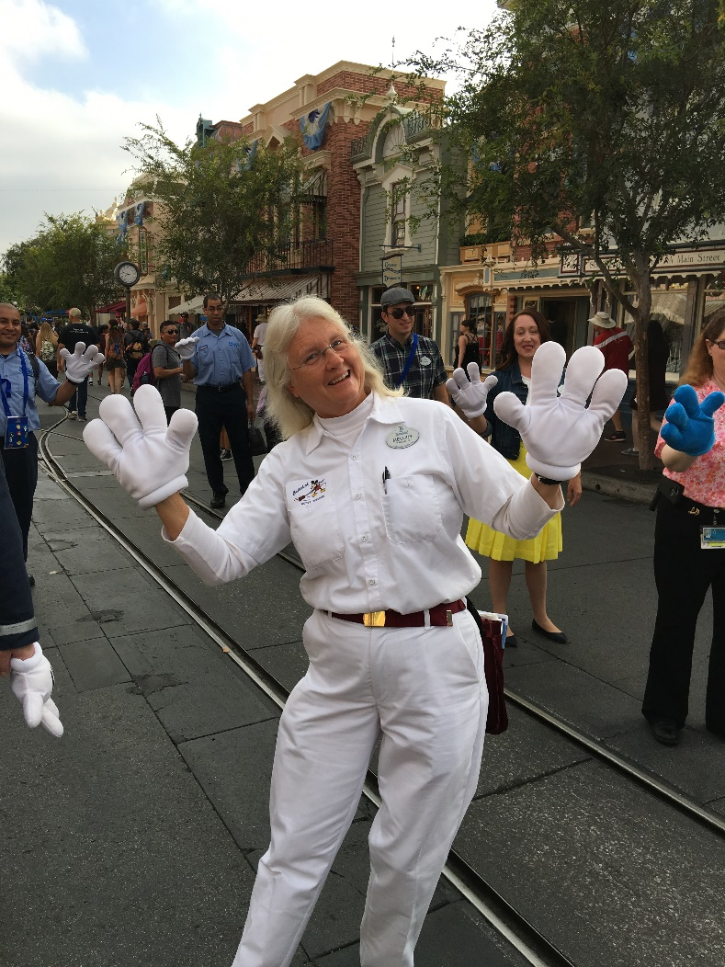
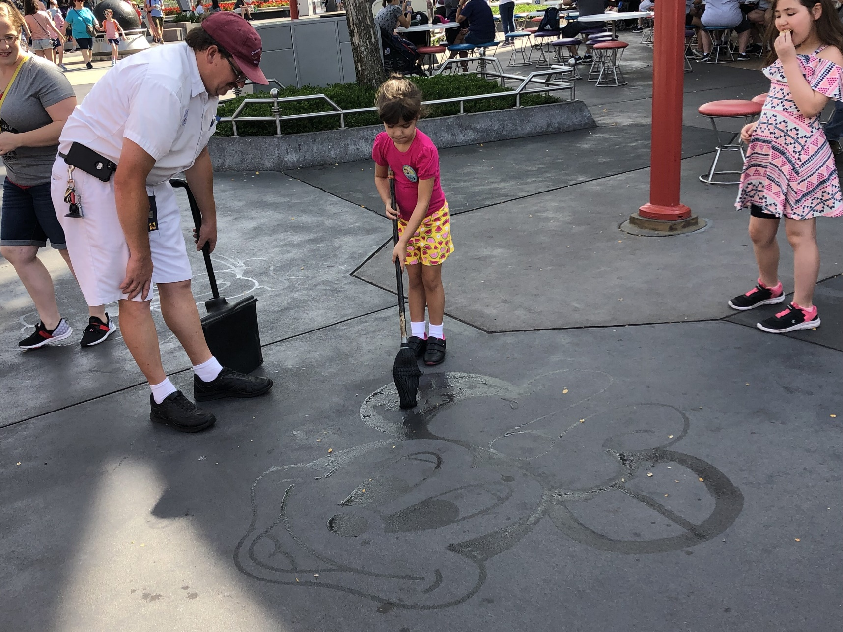
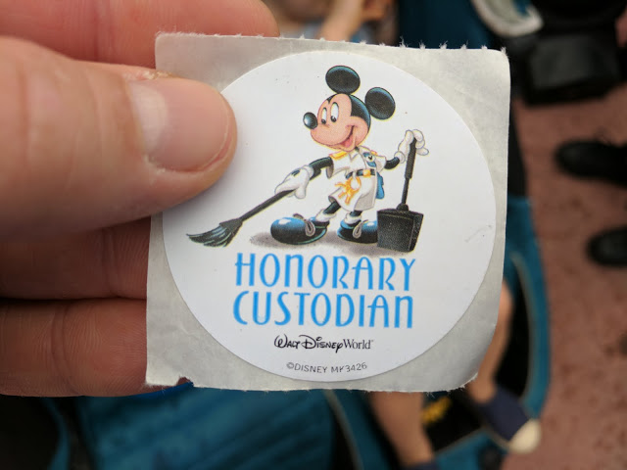
Learning from Disneyland
Elevating custodial operations through visibility

Slide 14
Tessei Recommendations
Concrete actions to make cleaning staff more visible to and interactive with customers?
New mission: Improve travel experience
New visible uniforms
Expand tasks, prepare them with FAQs
Empower the employees

Slide 15
Tessei Addressing Challenges
 | Old: Cleaning | New: Hospitality
Purpose | Cleaning trains | Helping customers
Visibility | Behind the scenes / hidden Drab uniforms “hide” employees Avoid customers | Interacting / transparent Colorful uniforms invite interaction Interaction encouraged (e.g., “the comet supervisor,” answering questions, accepting trash directly)
Interactions | Negative – pity, disgust, unhelpful | Positive – appreciation, feedback

Slide 16
Operational Transparency
…enhances appreciation of effort by customers, increasing employee satisfaction
Perceives more effort
Appreciates effort
Sees the work
Values service more
CUSTOMERS
EMPLOYEES
More effort
Feels more appreciated
More satisfied with job
Work feels meaningful

Slide 17
Transparency Summary
Operational Transparency: Deliberate design of windows into (“showing the work to customers”) and out of (“showing workers the customer”) an organization’s operations
 | Advantages |  | Disadvantages
For Customers | Appreciate effort Understand progress | Value service more Decreases waiting sensitivity | See things “don’t want to see”
For Employees | Feel more appreciated | Greater job satisfaction | Risks making work more difficult/stressful, less efficient
 | Open up operations to scrutiny |  | Both parties prefer the work be undertaken behind the scenes

Slide 18

Vibe Check #2
https://bit.ly/poms22vibe2

Slide 19
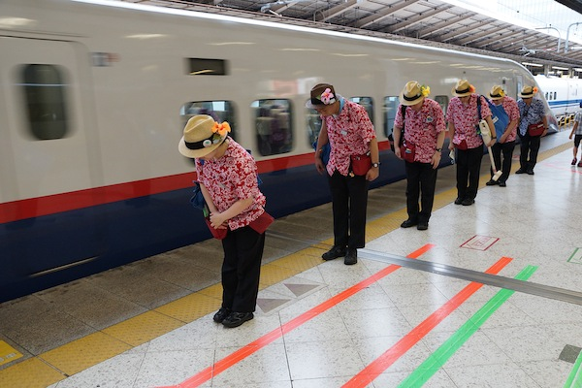
Good Luck!
Extended Office Hours:
Thursday 3-4pm at F598 (me)
Friday 2-3pm at Chou N455 (Hansheng)
Saturday 9-10pm on Zoom (me)
Sunday 7-9pm on Zoom (Hansheng)
HW3 due tonight 11:59pm (Solution at Friday’s Discussion)
Submit Project Preferences + Pick Leader Friday 11:59pm

